Slide 1
Data Pipeline Design & Implementation
Processing Raw Data from a Relational Database Rohit Kandel

Slide 2
Introduction
Objective
Design and implement a data pipeline to process raw data from a relational database.
Key Focus Areas:
Data extraction
Transformation
Storage format
Pipeline type
Notes:
This presentation outlines the pipeline design for processing raw data, including the choice of pipeline type, transformations applied, and the final data format.

Slide 3
Pipeline Overview Diagram
Diagram: A high-level flowchart with the following steps:
Extract – Retrieve raw data from the relational database.
Transform – Clean, normalize, apply feature engineering.
Load – Store the processed data in the chosen format (e.g., Parquet).
Notes:
This diagram represents the ETL (Extract, Transform, Load) process used in our pipeline. The pipeline is designed to handle structured data efficiently.

Slide 4
Pipeline Type
Batch Processing
Suitable for periodic data processing.
Works well for analytical workloads.
Ensures data consistency.
Notes:
A batch pipeline is preferred over streaming because we process data at scheduled intervals, ensuring efficiency in data validation and transformation.

Slide 5
Data Transformation Steps
Cleaning: Remove duplicates, handle missing values.
Normalization: Convert categorical variables into numerical form, scale numerical data.
Feature Engineering: Create new variables, aggregate data.
Notes:
Transformations are crucial to prepare data for downstream analytics and machine learning tasks.

Slide 6
Data Format Choice
Parquet
Efficient storage & retrieval
Columnar format optimizes analytical queries
Supports schema evolution
Notes:
Parquet is chosen for its high performance in analytics workloads. It reduces storage footprint and speeds up query execution.

Slide 7
Summary & Next Steps
Summary:
Designed a batch processing pipeline.
Defined transformations for data cleaning and preparation.
Chose Parquet as the final storage format.
Next Steps:
Implement the pipeline using Python & SQL.
Validate data integrity.
Automate and schedule execution.
Notes:
This concludes the design phase. The next step is implementation, ensuring the pipeline runs efficiently and meets business needs.

Slide 8
Data Quality Issues & Fixes
Missing Values → Check for nulls and flag if critical columns have over 5% missing. Fix by filling with mean/median or default values.
Duplicates → Detect by checking primary keys or similar records. Fix by removing exact duplicates and merging near-duplicates.
Outliers → Spot using Z-score or IQR. Fix by capping extreme values or replacing with median.

Slide 9
Detecting Data Drift & Schema Changes
Drift: Compare new data with past trends using statistical tests. Trigger alerts if distributions shift.
Schema Changes: Check column names, types, and constraints before processing. Alert on unexpected changes.

Slide 10
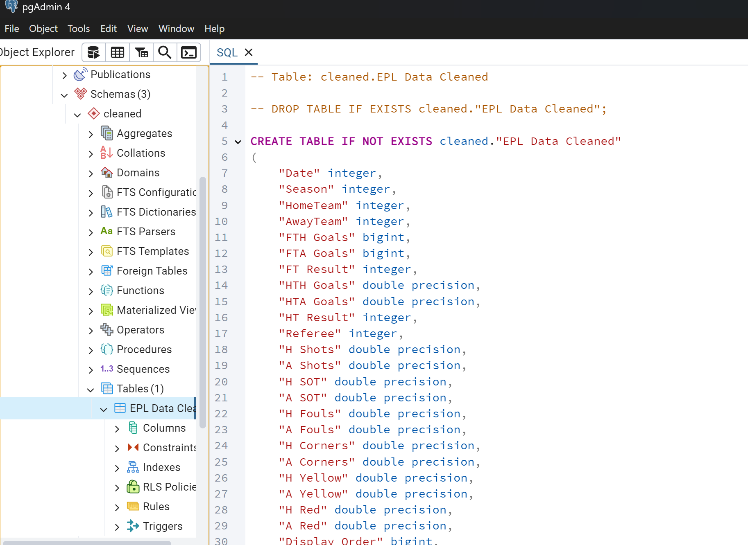
Screenshot of “Cleaned.EPL Data Cleaned”

